Slide 1
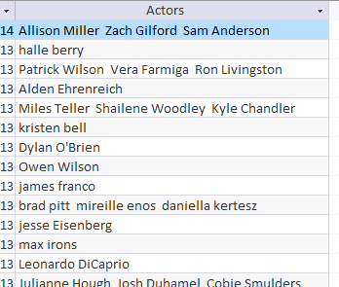
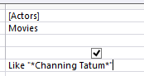
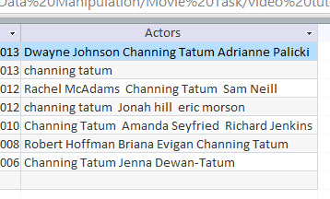
Wild Card – Sometimes a field may contain more than one word. To find something specific you need to write a wildcard search. Like “*Channing Tatum *”
Between | Between 01/01/2010 And 02/02/2012 Between 100 And 150
Or | North Sea Or Irish Sea
Not | Not “Horror”
<90 | Less than <90
>90 | More than >90
>=90 | More than and equal to >=90
37*____ | Fields starts with 37
____*37 | Fields Ends with 37
Only field containing Channing Tatum are shown

Slide 2
Query 1 Show the following Fields only: Movie Name, Genre, Price Show only the movies which have sold more between 10 And 30 copies Insert a new field called updated price which is calculated at a run time – You need to plus 10% to the price
Query 2 Show the following Fields only: Movie Name, In Stock, Type, Release Date Show only the movies which have a release date between 2011 And 2014 Insert a new field called updated price which is calculated at a run time – You need to plus 30% to the price
Query 3 Show the following Fields only: Movie Name, Genre, Release Date, Price and Actors Show only the movies which cast Channing Tatum and Robert Downey Insert a new field called updated price which is calculated at a run time – You need to plus 20% to the price
Query 4 Show the following Fields only: Movie Name, Type, Duration, Release Date, Price and Actors Show only the movies which cast Patrick Wilson and Tom Cruise Insert a new field called updated price which is calculated at a run time – You need to plus 35% to the price

Slide 3
Query 5 Show the following Fields only: Code, Movie Name, Genre, Release Date and Price Show only the movies which has 11 as the first two digits of the code. Insert a new field called updated price which is calculated at a run time – You need to plus 15% to the price
Query 6 Show the following Fields only: Code, Movie Name, Price, Duration Show only the movies which has 22 as the last two digits of the code. Insert a new field called updated price which is calculated at a run time – You need to plus 15% to the price
Query 7 Show the following Fields only: Movie Name, Genre, Sold, Price Show only the movies which are either Action or Horror. Insert a new field called updated price which is calculated at a run time – You need to plus 25% to the price
Query 8 Show the following Fields only: Movie Name, Genre, Price, Rating Show only the movies which are horror and have no rating. Insert a new field called updated price which is calculated at a run time – You need to plus 10% to the price
Query 9 Show the following Fields only: Movie Name, Type, Price, Sold Show only the movies which have sold 10 or more copies and are not horror movies. Insert a new field called updated price which is calculated at a run time – You need to plus 15% to the price

